Slide 1
Chap Research

Slide 2
Background/Intro
Rachel Gardner, CEO of Chap Research
Began XX
Has XX members
[mission statement or description of Chap Research]

Slide 3
The Goals
Give students the experience and confidence to succeed in college and career settings
Helping them start from scratch
Allow students to further explore/develop industry-applicable skills that are *not* taught in school
Pitching to “investors”
Working with customers
Developing ideas
Marketing products
Managing others

Slide 4
Our Projects

Slide 5
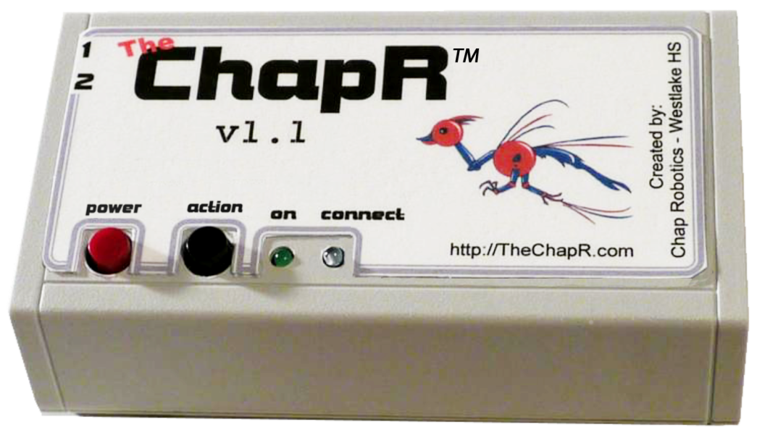
The ChapR
A remote control for FLL, FTC and FRC robots
FRC mode ready for beta!

Slide 6
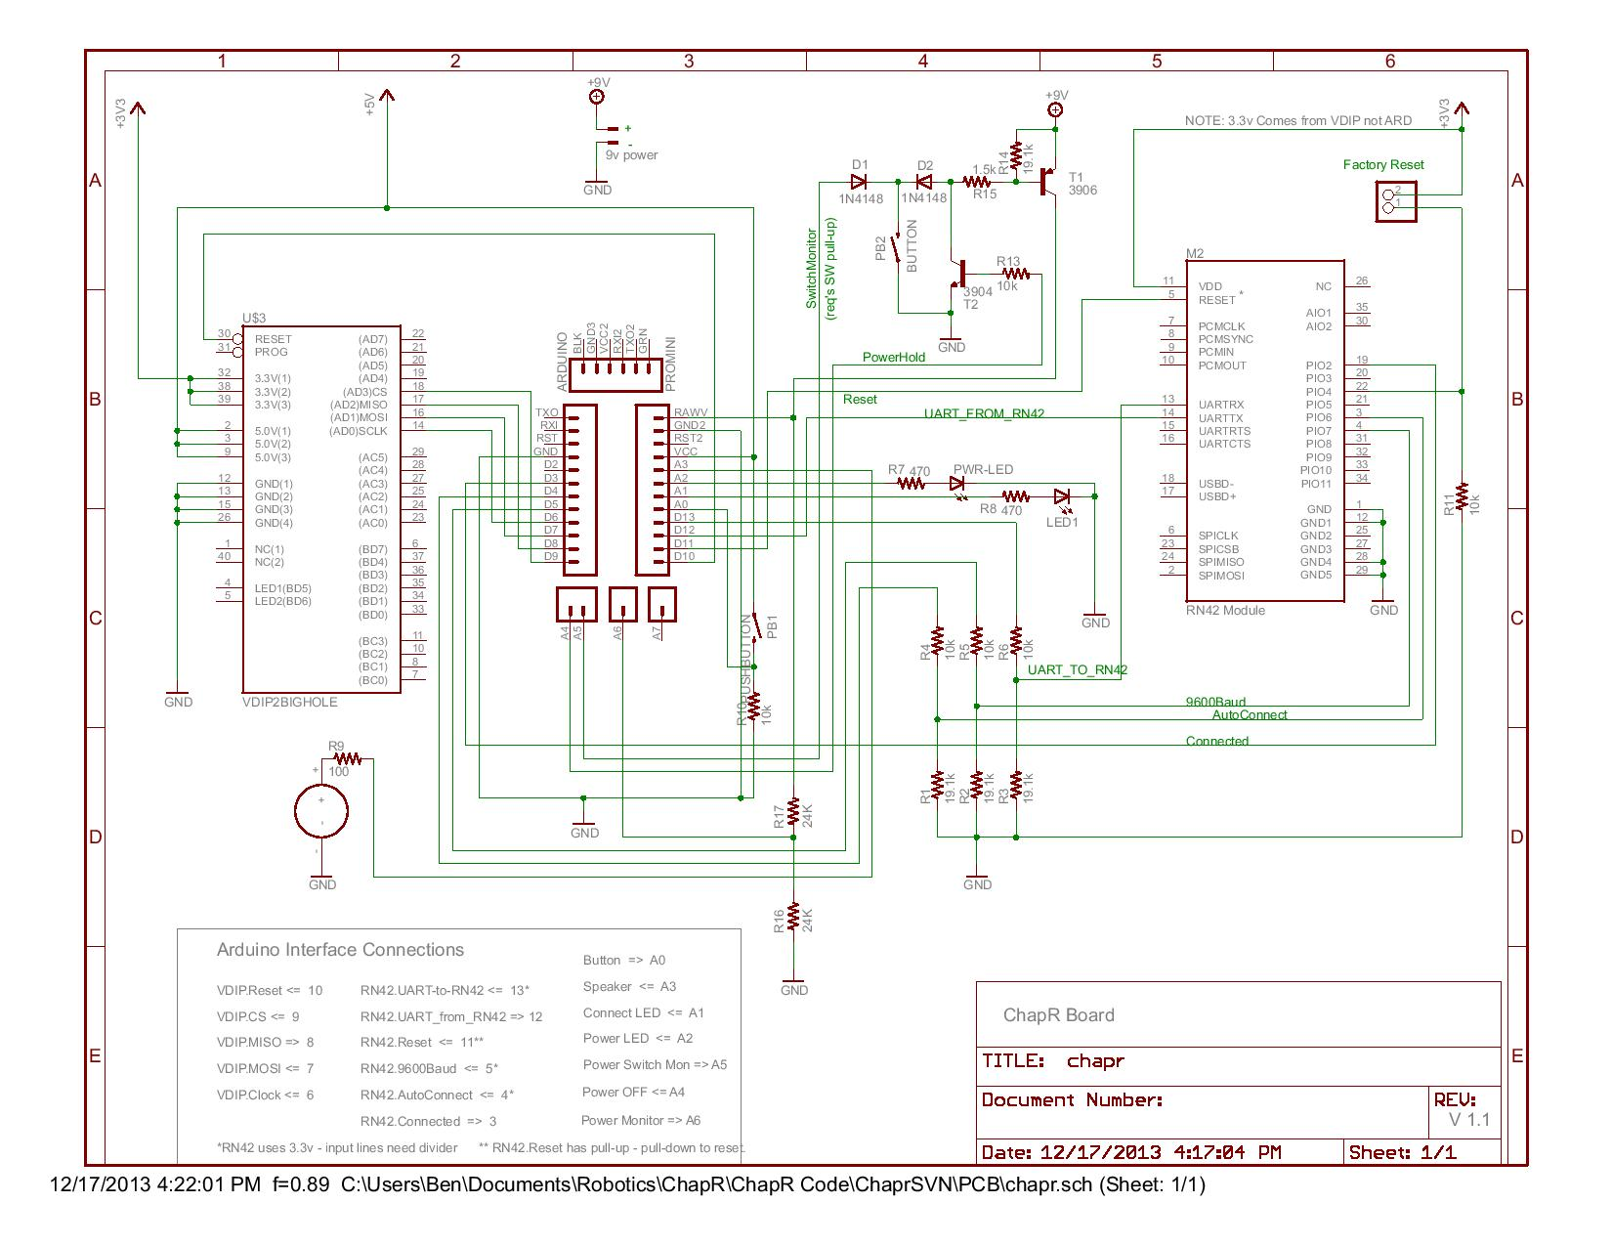
MXP BeatBoard
Separates sound into frequency bands
Could used to flash LEDs or actuate motors

Slide 7
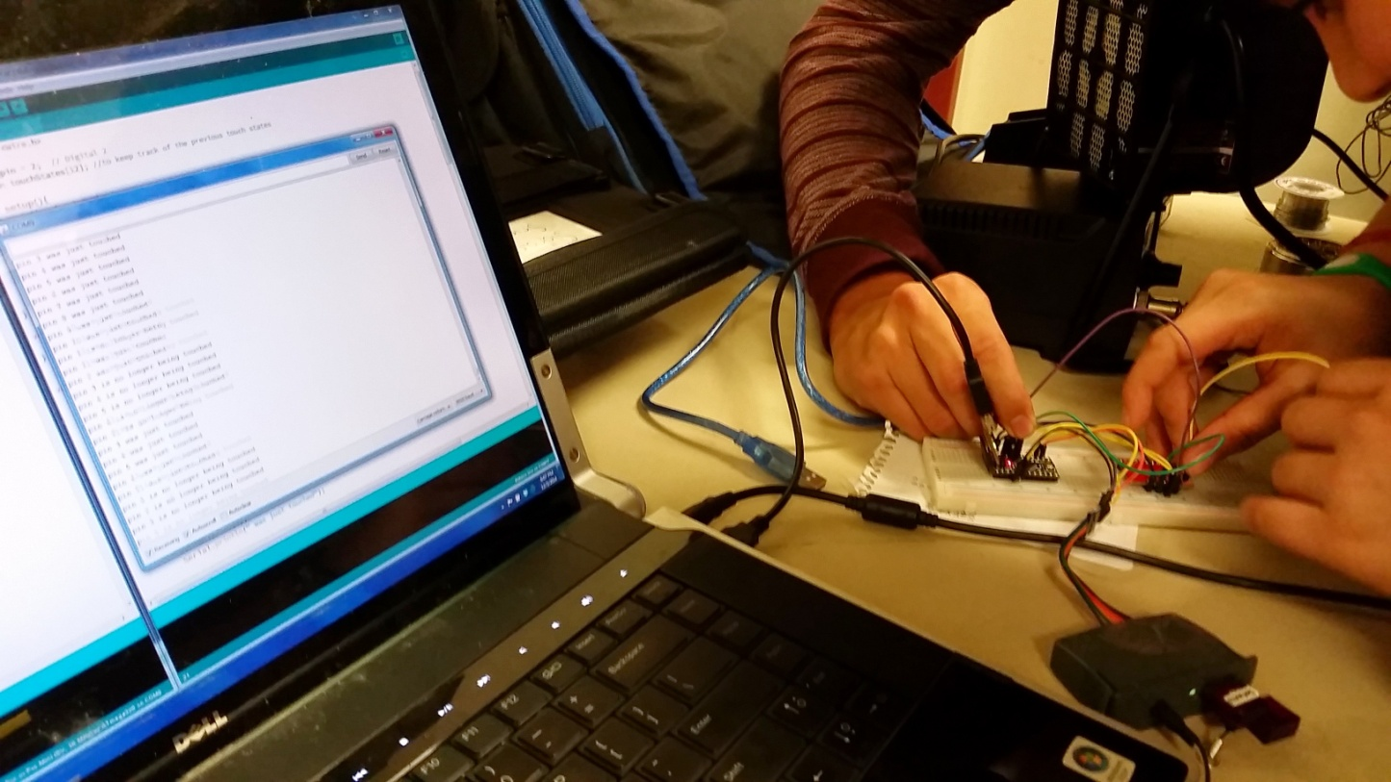
TedEx Labs Project
A spiral or basket of fruit to be used as touch sensors
Has “BopIt”, “Simon” and “Space Game” modes

Slide 8
The Process
Brainstorming session
Write/draw out ideas on a whiteboard
Research what’s been done
Ask mentors
Search the web
Set a timeline and divide up tasks
Just do it
Consult your resources as needed
Tell the world
Put it up on your website
Write a white paper
Get a patent

Slide 9
What It Takes

Slide 10
Space to Meet
Whiteboard
Chairs
Shelves

Slide 11
Management Structure
Board of Directors
A group of teachers and mentors whom the students report to on a weekly or monthly basis
Builds accountability
Gives practice presenting/selling ideas
CEO/Manager
One student held personally responsible for the success of the program
Project Leads
One student per project who is held responsible for the success of the project
Gives brief reports on respective projects at board of directors meetings
Individual Contributors
Members of individual subgroups, held responsible for meeting deadlines and small portions of their projects
Notes:
Schools are constantly telling us that everyone is equal and we are all peers, but that is not at all how companies operate
We need experience operating in a management structure

Slide 12
Resources
Mentors, industry experts, professors
Huge galvanizing force, but then involved as little as possible
After a student has done one project, he/she should be able to try to lead one

Slide 13
Reflections
Always work it out on your own before trying to teach it
For me, that was coding the project, then starting from scratch with my student
Allows you to focus on teaching and engaging, rather than solving the problem and letting your student watch
Always put someone on the hook and set a date
Aka never let someone assume the other members of the group will get it done
Document everything!!!
We have been bad about this, and we constantly regret it
Put someone in charge of taking pictures, organizing notes etc.

Slide 14
Succession
4 year turnover means constantly training new members
Take on projects of varying difficulty so the less experienced can learn from the beginning
Have experienced members host (film and publish) training sessions on basic skills needed for a project

Slide 15
Student Motivators
Experience not given by school curriculum
Kudos from peers/mentors/community
College app and resume builder
Desire to see the project to completion

Slide 16
Contact Us
Interested in Beta Testing for us?
Want to win the entrepreneurship award?
chapresearch.org/com/net/edu
thechapr@gmail.com
Notes:
With build season, this is bound to be a lower priority
However, it is something to begin thinking about, especially if you are striving toward the entrepreneurship award
We are still working on trying to be a good role model ourselves

